Slide 1

CAPSTONE PROJECT
UNLEASHING INSIGHTS FROM FOOTBALL DATA
PRESENTED BY: MANDAR MALEWAR
MENTORED BY: SHARAYOO DIXIT

Slide 2
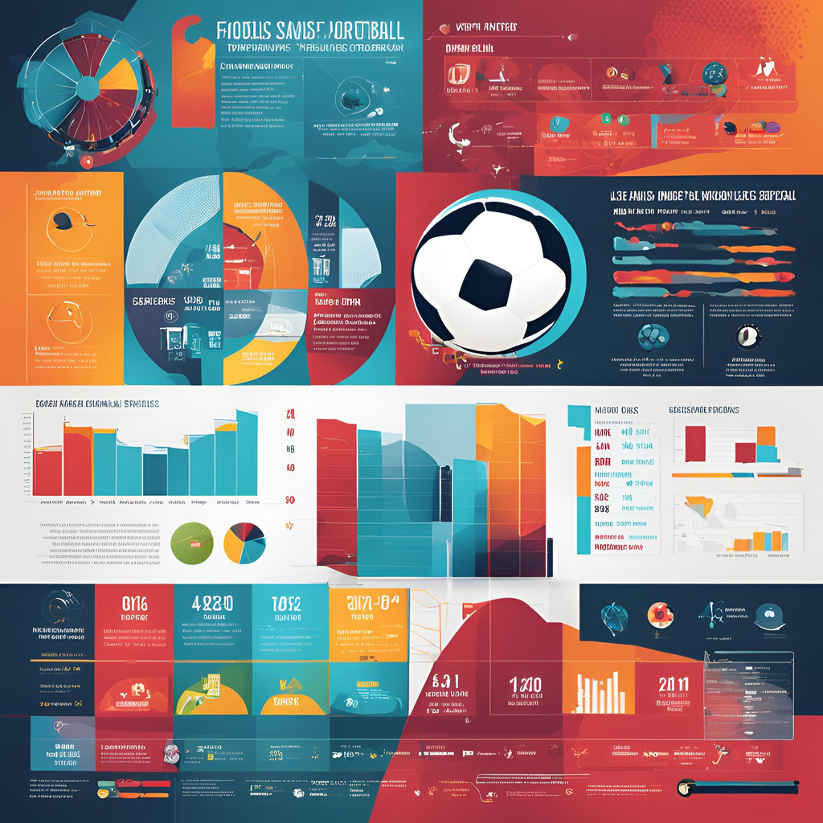
Introduction
Football data analysis is the process of collecting, cleaning, and analyzing data to extract meaningful insights which is used to improve player performance, team tactics, fan engagement, and overall decision-making.
Various data analysis techniques, like Exploratory Data Analysis (EDA) and correlation, prediction using ML models using tools like Python, MySQL, Excel, and Tableau are employed to extract meaningful insights. These insights aim to enhance decision-making, improve team performance, and provide a competitive edge in the sport.

Slide 3
Business Objectives
1. Performance Analysis-
Evaluate and analyze player performance based on metrics such as goals, assists, yellow cards, red cards, and minutes played.
Assess team performance in terms of home and away goals, club positions, and manager influence.
2. Player Profile and Market Value-
Identify key factors influencing player market value, such as performance, position, and age.
Track player development trends to predict future market values.
3. Team Comparison-
Compare team performance across various competitions and seasons.
Identify strengths and weaknesses of teams relative to competitors.
4. Attendance and Stadium Analysis-
Analyze factors influencing game attendance, such as stadium location, team performance, and competition type.
Assess the impact of attendance on club revenue and fan engagement.
5. Referee Analysis-
Evaluate referee performance based on decisions such as fouls, cards, and penalties awarded.
Assess the impact of referee decisions on game outcomes.

Slide 4
Business Objectives
6. Substitution Patterns-
Analyze substitution patterns to understand tactical decision-making.
Evaluate the impact of substitutions on game outcomes and player performance.
7. Event Analysis-
Analyze key game events such as goals, cards, and substitutions to identify patterns.
Assess the timing and frequency of critical events in games.
8. Competition Analysis-
Compare competition formats and their impact on team and player performance.
Identify trends in competition outcomes over multiple seasons.
9. Player Attributes and Demographics-
Examine the role of player demographics (age, nationality, height, etc.) in performance and market value.
Identify trends in player development and positional attributes.
10. Contract Management-
Analyze the impact of contract length and expiration on player performance and transfer activity.
Assess trends in contract renewals and terminations.

Slide 5
Data Preprocessing Techniques

Slide 6


Data Preprocessing Flow
Import datasets
Merge datasets
Remove redundant columns
Missing value treatment
Save cleaned file
Outlier assessment & treatment
Create data dictionary
Feature scaling
Feature reduction
Label encoding

Slide 7
Application of Data Analysis Techniques

Slide 8
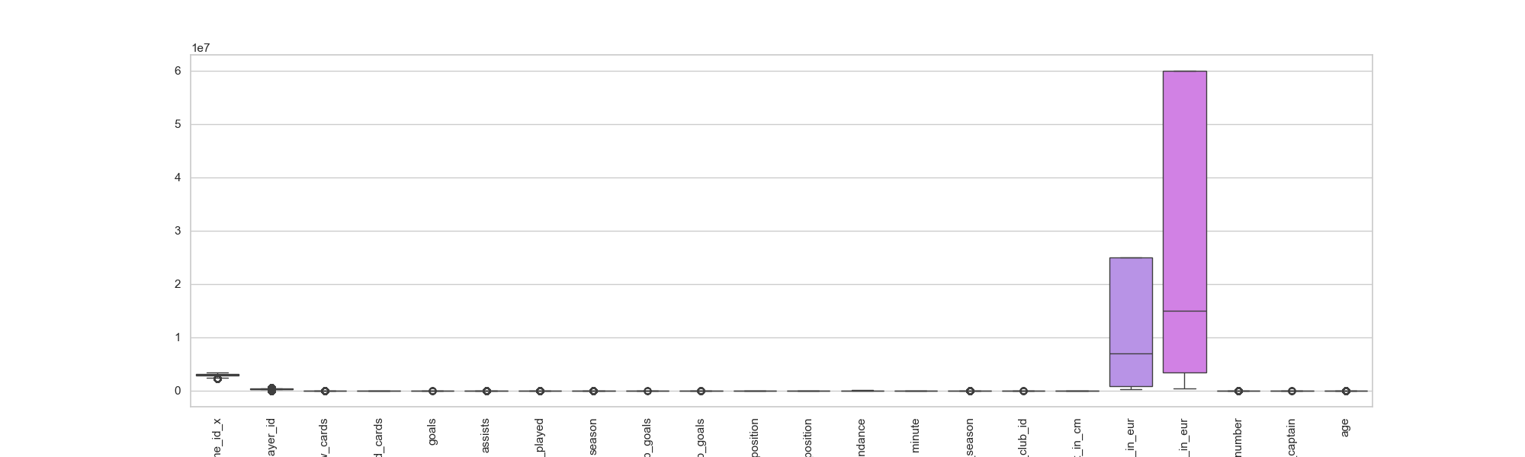
Outlier Assessment
Outliers were present in the merged data file (indicated by dots below)
Outliers were treated using iqr_winsorization technique
No outliers were found post outlier treatment
01
02
03

Slide 9
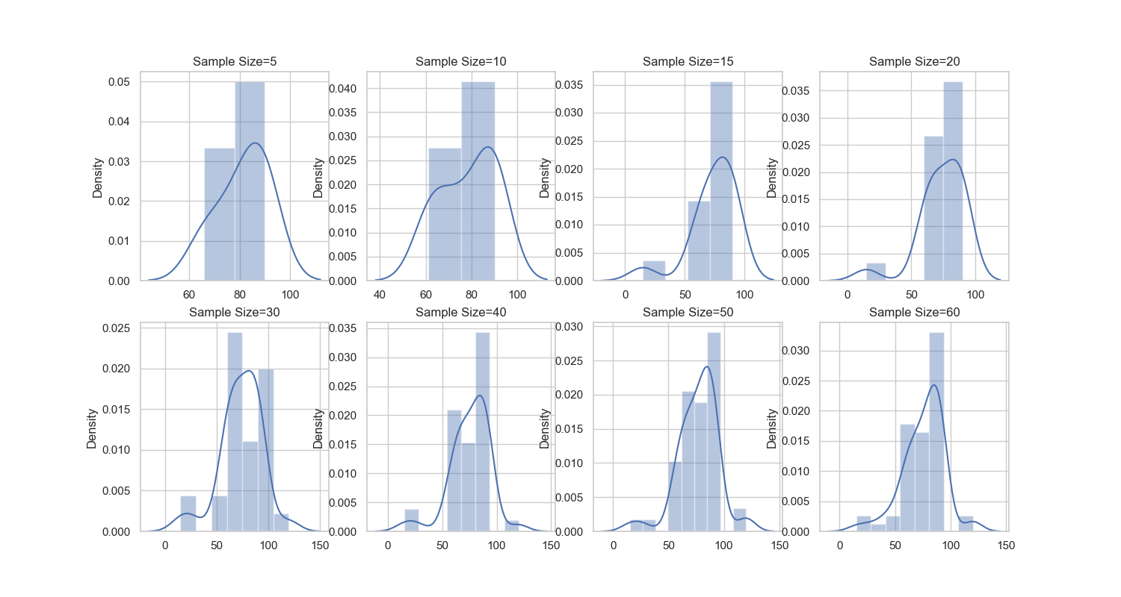
Normal Probability Distribution
Probability distribution of minutes_played feature for varying sample sizes
Samples with a size of 30 or larger exhibit a trend towards a normal distribution
01
02

Slide 10
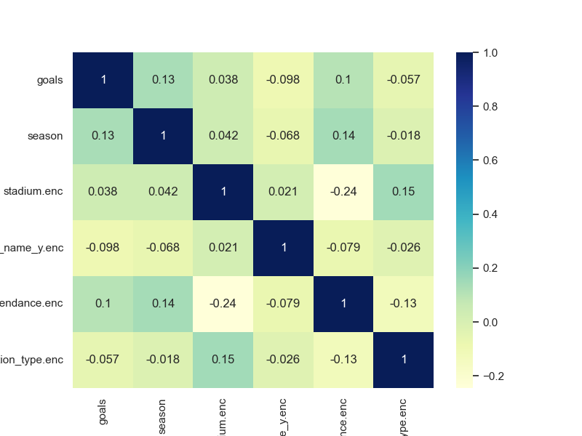
Feature Reduction using Selection
Reducing number of features under consideration by obtaining important features
01
Correlation heatmap shows the most relevant features with good correlation with target feature
02
Checking multicollinearity between independent features and eliminating them
03

Slide 11
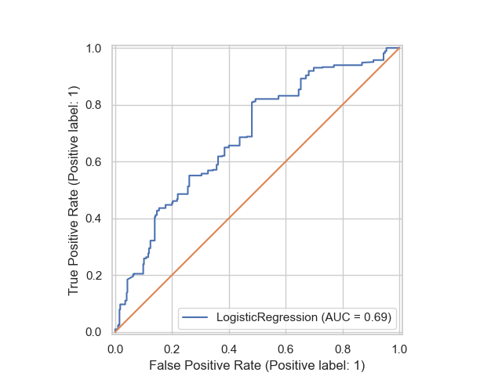
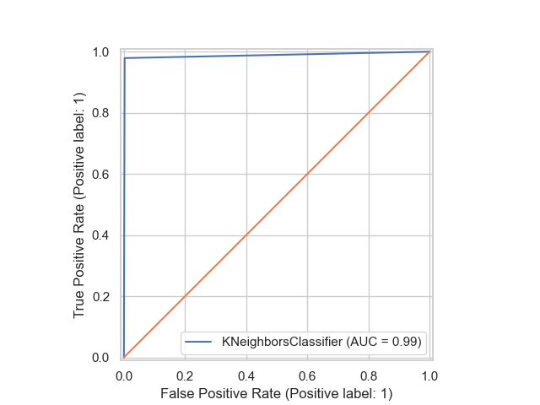
ROC Curve
Indicator for binary classification model for predicting attendance
Logistic regression model’s performance is average
KNN classification model’s performance is near perfect
01
02
03

Slide 12
Data Visualization Techniques

Slide 13
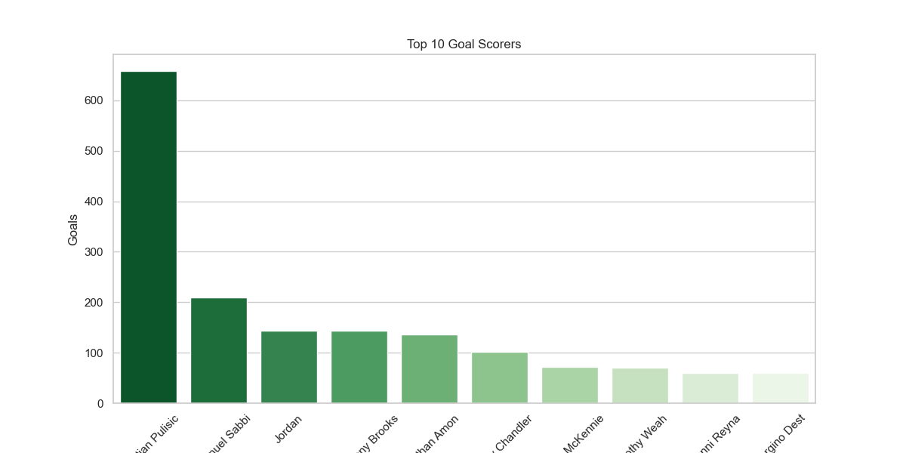
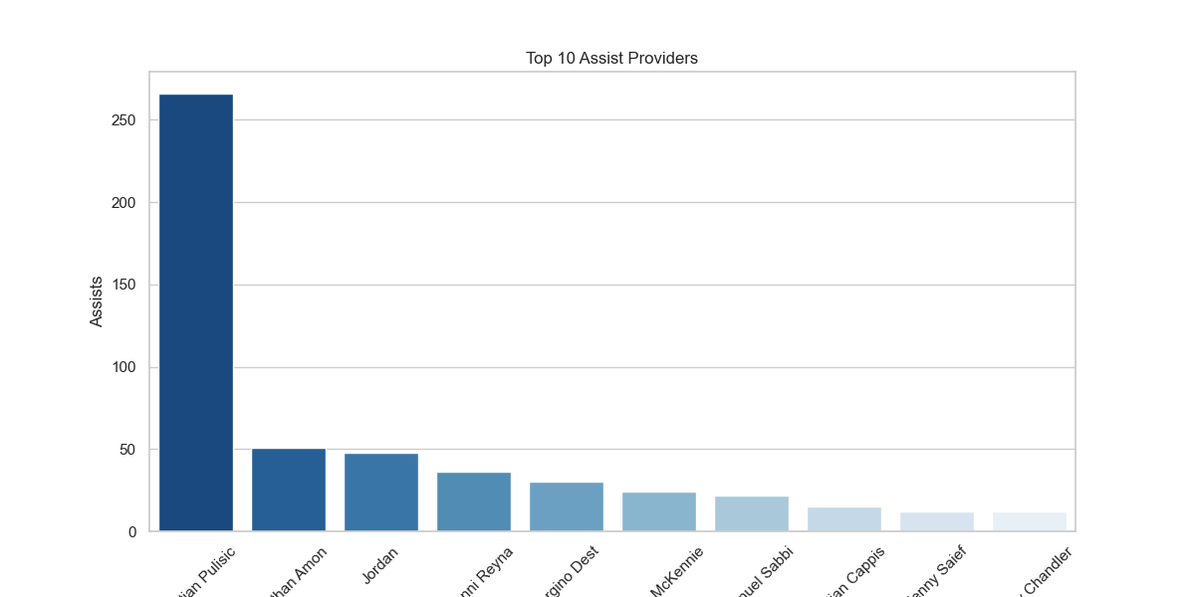
Top 10 Footballers
01
The best player is Christian Pulistic with highest number of goals and assists scored

Slide 14
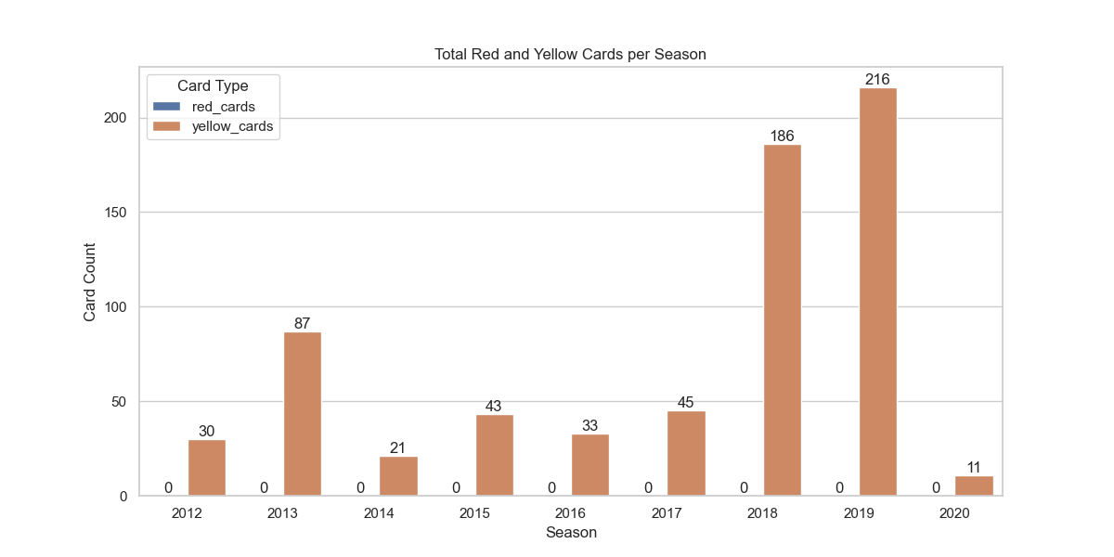
Season wise Cards Shown
2019 season had the highest number of yellow cards shown to players
01
No red cards were shown to any player in all the seasons
02

Slide 15
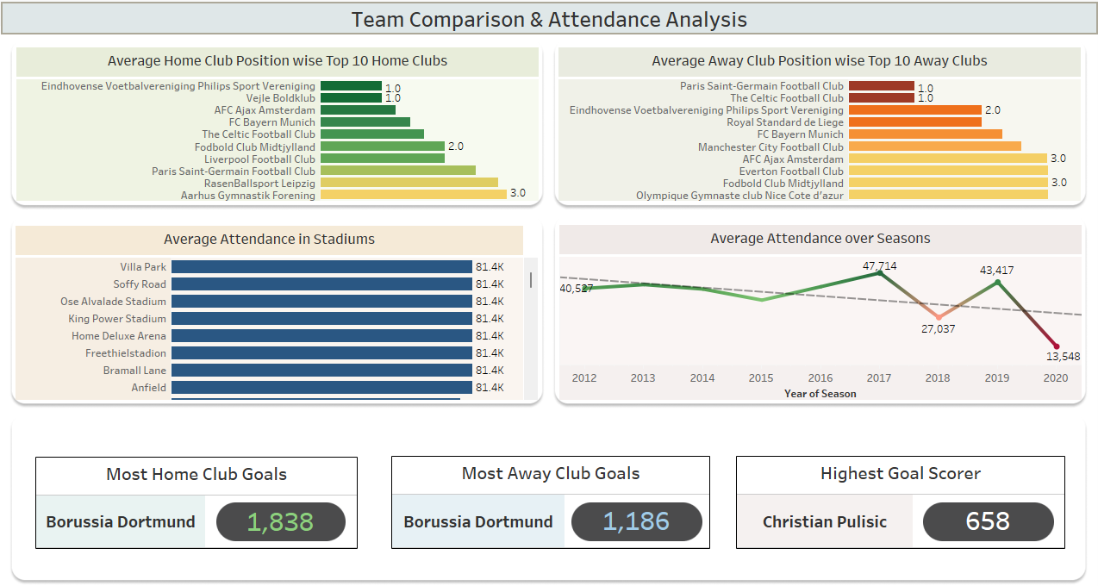
Dashboard 1

Slide 16
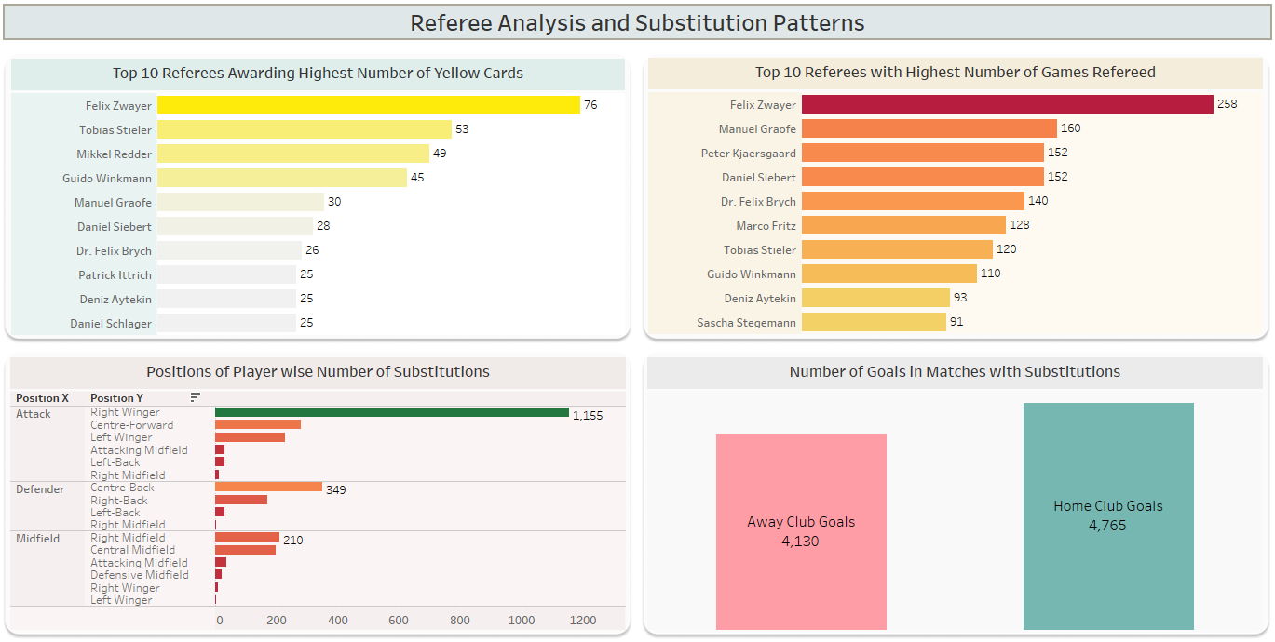
Dashboard 2

Slide 17
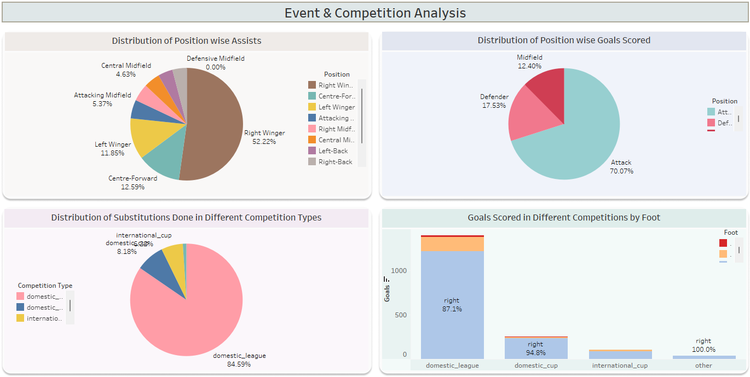
Dashboard 3

Slide 18
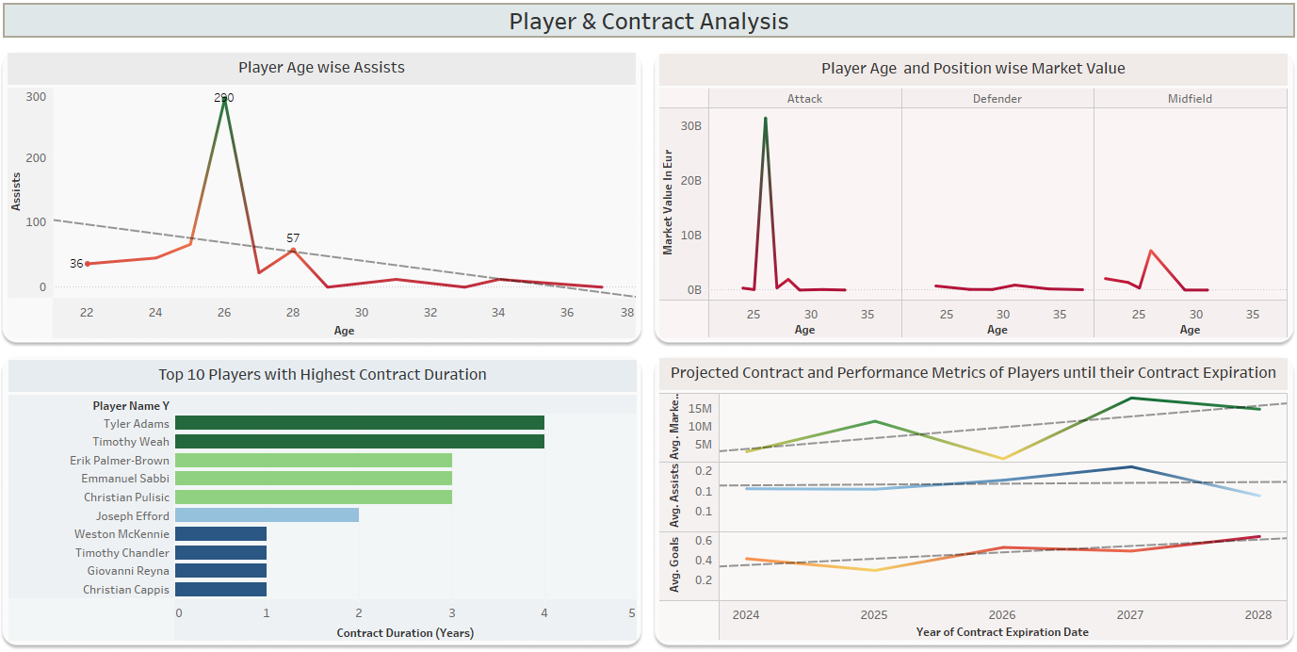
Dashboard 4

Slide 19
Summary
1. Christian Pulisic is the best scorer with 658 goals and 266 assists.
2. Number of minutes_played and assists have very high correlation with goals scored.
3. Top team in home performance is Borussia Dortmund. Top team in away performance is Royal Standard de Liege.
4. Probability that a player scores a goal given that they played at least 60 minutes= 0.41.
5. Joint probability of a player providing an assist and scoring a goal= 0.00.
6. the higher the total number of goals scored per season, the better the final finishing position of the club.
7. Number of goals scored by players peaked at 26 years of age and decreased as per increasing age.
8. Features with the highest correlation values with market_value_in_eur are- away_club_goals, goals, minutes_played, home_club_goals.
9. There is no significant difference in the average home_club_goals and away_club_goals scored.
10. There is significant difference in the average number of goals scored by right foot and left foot.

Slide 20
Business Conclusions
1. The higher the total number of goals scored per season, the better the final finishing position of the club.
2. The higher the number of goals scored, the higher is the player's market value.
3. Logistic regression model for classifying high and low attendance shows average performance.
4. Logistic regression model for predicting goals scoring shows moderate performance.
5. Young players performed the best meaning player performance decreases significantly with age.
6. Simple linear regression model shows very poor performance in predicting market_value_in_eur based on away_club_goals.
7. Multiple linear regression model demonstrates a clear improvement in market_value_in_eur prediction accuracy but it is still extremely poor model to use for market_value_in_eur prediction.
8. KNN classification model's performance is excellent for attendance assessment in comparison to the logistic regression model.
9. K-Means Clustering classification model shows good performance for predicting dominant foot of players.

Slide 21
THANK YOU

